Slide 1

SIMPLE BANKING SYSTEM
A SIMPLE MINI PROJECT OF BANKING SYSTEM
BY :
SIVAKKUMAR .N
SRI SABARI BALAJI.S
SUGASHINI.S
TAMILSELVI .M
VISHAL.S

Slide 2

PROJECT OVERVIEW
OBJECTIVE :
TO CHECK AND PERFORM MULTIPLE BANK DETAILS
KEY FEATURES :
INPUT :
CREATE ACCOUNT
DEPOSIT MONEY
WITHDRAW MONEY
CHECK BALANCE
EXIT
OUTPUT :
BALANCE(AFTER CREATING ACCOUNT)
BALANCE(AFTER DEPOSITING MONEY)
BALANCE(AFTER WITHDRAWING MONEY)
BALANCE
CONCEPTS USED :
FUNCTIONS
BASIC ARITHEMATIC
CONTROL FLOW

Slide 3

STEPS IN PROGRAM
CREATE ACCOUNT :
GETTING A ACCOUNT NUMBER AND NAME AS AN INPUT AND SHOW THE INITIAL BALANCE AND BANK CONDITION.
DEPOSIT MONEY :
GETTING A ACCOUNT NUMBER AND AMOUNT OF DEPOSIT AS AN INPUT AND ADD AMOUNT OF DEPOSIT TO INITIAL BALANCE AND SHOW THAT IF THE ACCOUNT NUMBER MATCHES THE PREVIOUS ACOUNT NUMBER GIVEN IN CREATE ACCOUNT
WITHDRAW MONEY :
GETTING A ACCOUNT NUMBER AND AMOUNT TO WITHDRAW AS AN INPUT AND SHOW WITHDRAW SUCCESSFUL IF WITHDRAW AMOUNT IS LESS BALANCE OTHERWISE SHOW SHOW BALNCE IS INSUFFICIENT IF ACOUNT NUMBER MATCHES.
CHECK BALANCE:
GETTING ACCOUNT NUMBER AS INPUT AND SHOW BALANCE IF ACCOUNT
NUMBER MATCHES

Slide 4

#include<stdio.h>
int main()
{
int a;
int fo=1;
float balance=0.0;
float num1,num2,num3,num4;
float bal,with,rem;
printf("\n1.CREATE ACCOUNT\n2.DEPOSIT MONEY\n3.WITHDRAW MONEY\n4.CHECK BALANCE\n5.EXIT");
printf("\nENTER THE OPTION NUMBER FROM THE LIST:");
scanf("%d",&a);
while(1){
switch(a){

Slide 5
//creating account:
case 1:
printf("ENTER YOUR ACCOUNT NUMBER:");
scanf("%f",&num1);
char name[50];
printf("ENTER YOUR NAME:");
scanf("%s",name);
printf("YOUR BALANCE IS %f",balance);
printf("\nyour account is created successfully:)");
printf("\nPLEASE DEPOSIT ATLEAST 500 TO AVOID PENALTY\n");
break;

Slide 6
case 2:
//depositing money:
printf("ENTER YOUR ACCOUNT NUMBER:");
scanf("%f",&num2);
if(num1==num2){
float money_deposit;
printf("ENTER A AMOUNT TO DEPOSIT:");
scanf("%f",&money_deposit);
bal=balance+money_deposit;
printf("YOUR BALANCE IS :%f",bal);}
else{
printf("NO ACCOUNT EXIST IN THIS ACCOUNT NUMBER");
}
break;

Slide 7
case 3:
//withdraw money:
printf("ENTER YOUR ACCOUNT NUMBER:");
scanf("%f",&num3);
if(num3==num1){
printf("ENTER A AMOUNT TO WITHDRAW:");
scanf("%f",&with);
if(with<=bal){
rem=bal-with;
printf("%f WITHDRAWED SUCESSFULLY!",with);
printf("\nYOUR BALANCE IS %f",rem);
}
else{
printf("YOUR BALANCE IS NOT SUFFICIENT");
printf("\nYOUR BALANCE IS %f",bal);
}
}
else{
printf("NO ACCOUNT EXIST IN THIS ACCOUNT NUMBER");
}
break;

Slide 8

case 4:
//check balance:
printf("ENTER YOUR ACCOUNT NUMBER:");
scanf("%f",&num4);
if(num4==num1){
printf("YOUR BALANCE IS:%f",rem);
}
else{
printf("NO ACCOUNT EXIST IN THIS ACCOUNT NUMBER");
}
break;
case 5:
fo=2;
break;
default:
printf("INVALID OPTION NUMBER");
}
if(fo==2){
printf("\t\t\t\t\tTHANKYOU");
break;
}

Slide 9
printf("\n1.CREATE ACCOUNT\n2.DEPOSIT MONEY\n3.WITHDRAW MONEY\n4.CHECK BALANCE\n5.EXIT");
printf("\nENTER THE OPTION NUMBER FROM THE LIST:");
scanf("%d",&a);
}
return 0;
}

Slide 10
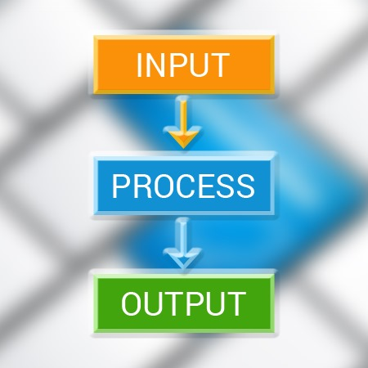
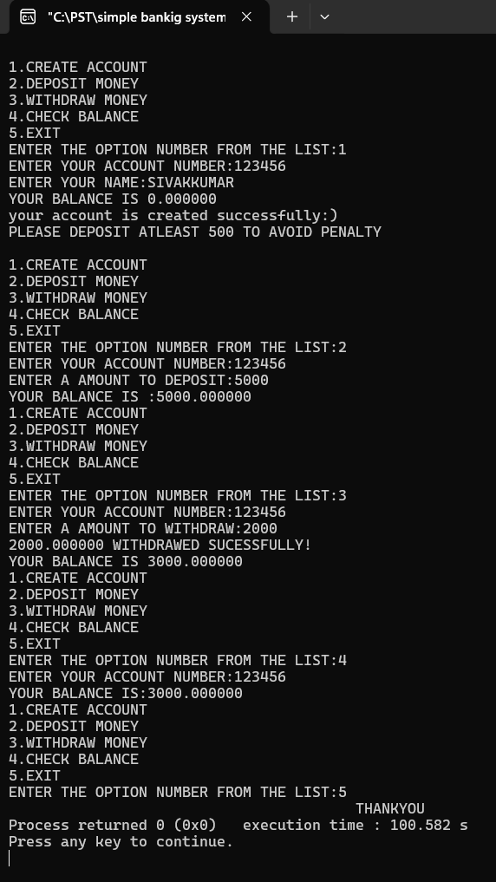


Slide 11


SIMPLE AND EASY TO UNDESTAND
ACCURATE RESULT FOR VALID QUESTION
DEMONSTRATES CORE C PROGRAMMING CONCEPTS
USEFUL AND MORE EFFICIENT
PEOPLE CAN UNDERSTAND EASILY
MORE SUFFICIENT

Slide 12



*DON’T HESISTATE TO ASK QUESTIONS ON OUR PROJECTS .
*WE WOULD BE VERY PROUD TO ANSWER YOUR QUESTIONS .
*WE ALL DO HAVE HERE TO ANSWER YOU.
*AND WE DO HAVE THE KNOWLEDGE TO ANSWER YOU.

